Slide 1
Introduction to continuous integration and continuous delivery using containers and Kubernetes
Nills Franssens
App Innovation specialist
@nillsf
https://blog.nillsf.com

Slide 2
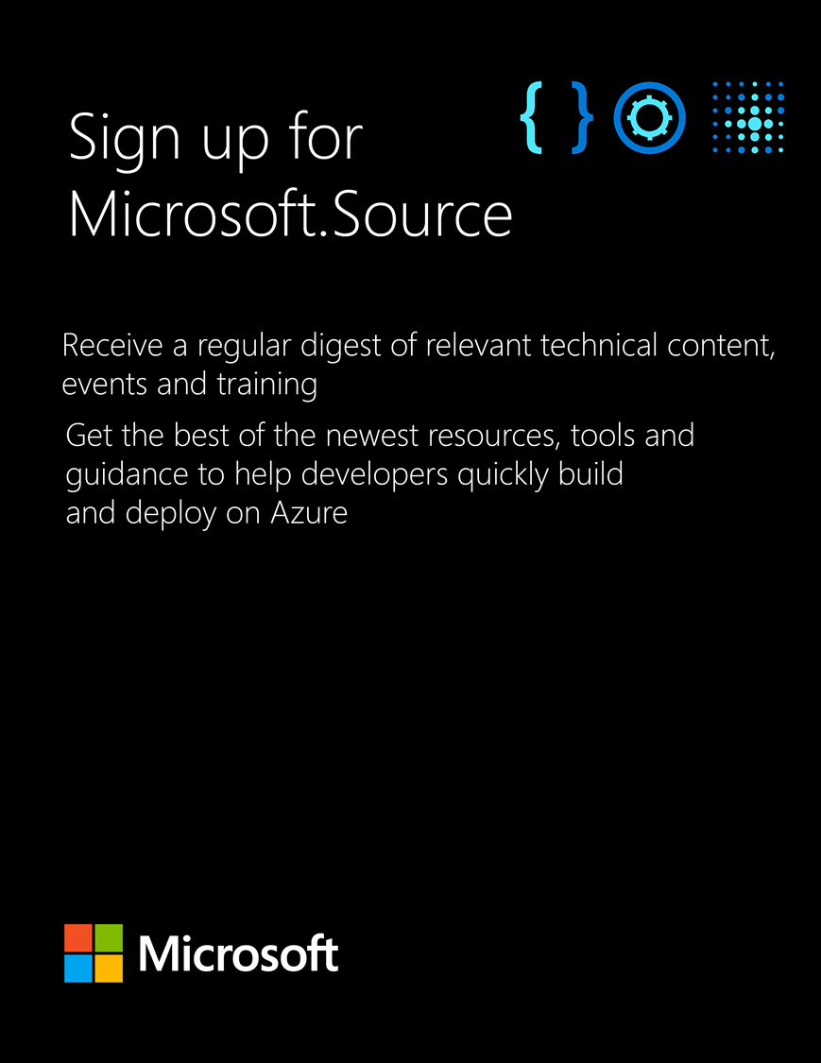

Get the latest articles, documentation, and events from Microsoft.Source—the curated monthly developer community newsletter.
Stay at the forefront of rapidly evolving technologies with resources that are relevant to your field, location, and areas of interest—including articles, GitHub repositories, and how-to guides.
Get notified about events—from local hacks, workshops, and training sessions to virtual meetups and global conferences.
Learn what you want, when you want, how you want. Resources include in-person hands-on workshops, free, interactive online training and sandbox environments.
Dev.level(up);
aka.ms/lrtf
.source

Slide 3
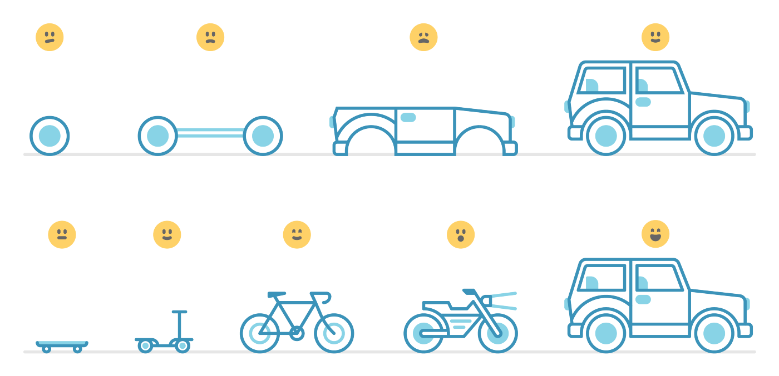
Image taken from: https://awilkinson.medium.com/skateboard-bike-car-6bec841ed96e

Slide 4

Let’s start with a quick intro to containers and kubernetes

Slide 5
Containers are a way to package software + dependencies
Application
Runtime binaries
Dependencies
Container

Slide 6
Example: python application + dependencies
app.py
Python runtime
pip packages
Container

Slide 7
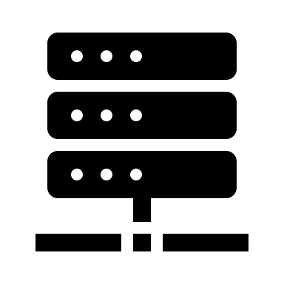
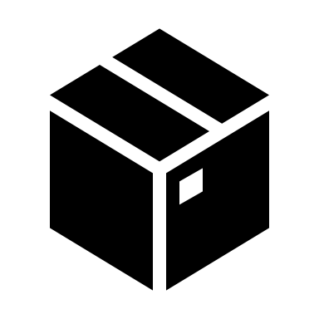
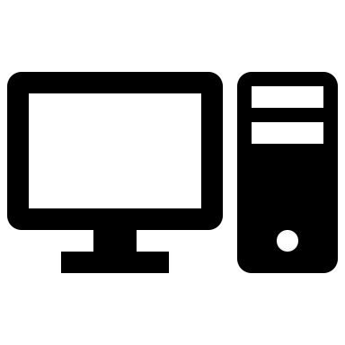
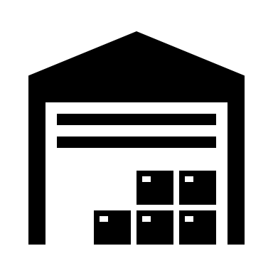

Container images are pushed to a container registry so other systems can use them.
Build image
Server
Pull image
Push image
Registry

Slide 8
Kubernetes is used to orchestrate containers
Portable
Public, private, hybrid, multi-cloud
Extensible
Modular, pluggable, hookable, composable
Self-healing
Auto-placement, auto-restart, auto-replication, auto-scaling

Slide 9

How Kubernetes works:
Registry
Pull container
image
YAML
API
Submit
configuration
Schedule
container
Kubernetes cluster

Slide 10

You should never do this in a production scenario

Slide 11
Continuous integration and continuous delivery

Slide 12
Definitions
Continuous integration
Practice of continuously testing and building software
Output is a deployable artifact
Continuous delivery
Practice of continuously releasing software
Deploy the artifact frequently

Slide 13

Impact of CI/CD on software delivery
2021 | High Performers | Medium Performers | Low Performers
Deployment Frequency | Multiple per day | 1 week – 1 month | 1 week – 1 month
Lead Time For Changes | <1 hour | 1 week – 1 month | 1 week – 1 month
MTTR | <1 hour | <1 day | 1 day – 1 week
Change Failure Rate | 0-15% | 0-15% | 31-45%
Software Delivery
Performance

Slide 14


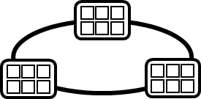

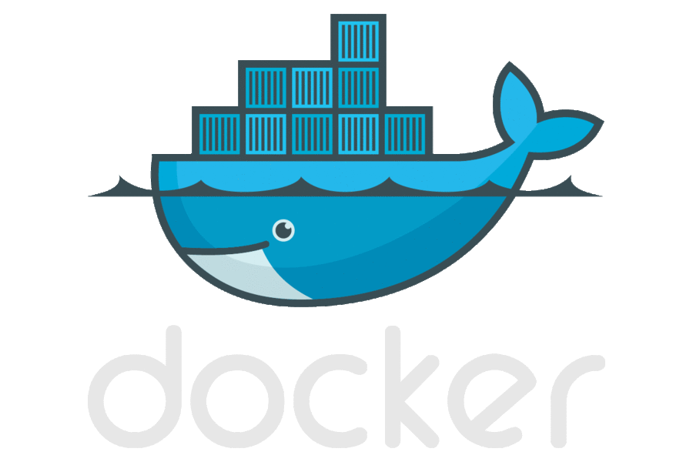
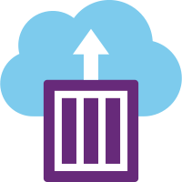


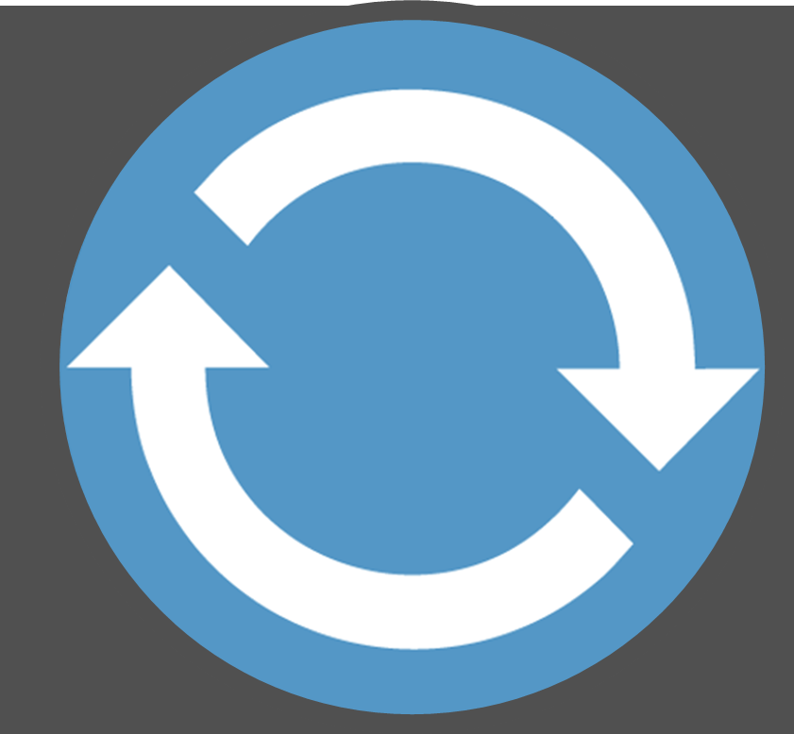
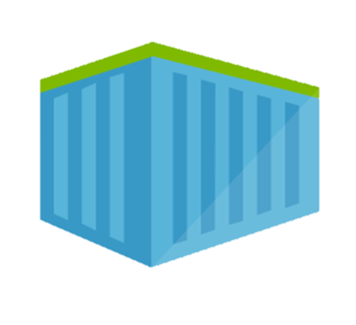
End-to-end container CI/CD pipeline
2.
3.
4.
5.
Source Code Control
(SCC)
Build/CI,
Integrate,
Test
Run, Manage
CD, Deploy
Production
environments
Container Registry
Push
code
Inner-Loop
6.
1.
Run
Monitoring
Code
Validate
Debug
Outer-Loop

Slide 15
Container-based continuous integration
Build and test software (with or without container)
Package in container image
Store container image in registry

Slide 16
A new way to fix security issues
Keeps starting
new containers
Security issue in container image
Server
What now?
Pull image
Registry
New server
Pulls in image
Server

Slide 17
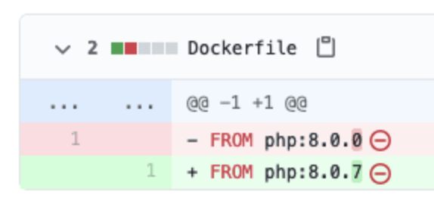
The CI step is the solution
2.
3.
4.
5.
Source Code Control
(SCC)
Build/CI,
Integrate,
Test
Run, Manage
CD, Deploy
Production
environments
Container Registry
Push
code
6.
Monitoring

Slide 18
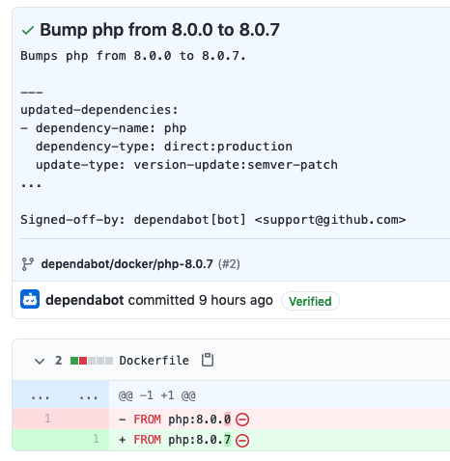
GitHub dependabot
GitHub tool
Automatically scans repos
Creates PRs automatically
Trigger pipeline and test runs

Slide 19
Demo: Container-based continuous integration

Slide 20
Two approaches for Kubernetes-based CD
Push-based
Pull-based

Slide 21
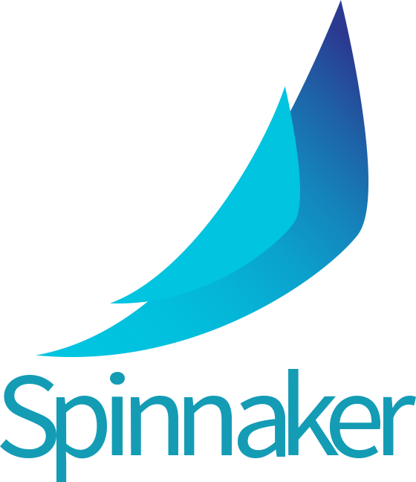

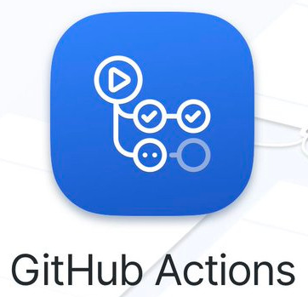
Approach 1: Push-based continuous delivery
Traditional approach
External system pushing updates to cluster
Release process
CI build
Container Registry
Dev cluster
QA cluster
Pre-prod cluster
Prod cluster
kubectl apply
helm install
External System
Release pipeline
Jenkins

Slide 22
Demo: Push based continuous delivery

Slide 23
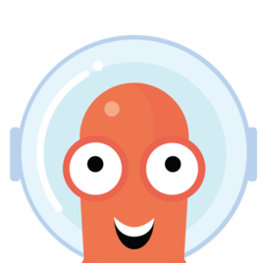

Approach 2: Pull-based continuous delivery (GitOps)
Cluster component
Declarative state in git
Release process
CI build
Container Registry
Dev cluster
QA cluster
Pre-prod cluster
Prod cluster
ArgoCD

Slide 24
Demo: Pull-based continuous delivery (GitOps) using FluxCD

Slide 25
Comparing push and pull based systems
Push-based | Pull-based (GitOps)
Access and credentials to Kubernetes API | Runs in cluster – leverage clusterRoles in
No guaranteed declarative state | Declarative state
Run once | Continuous (timer based)
Can auto-promote after tests | Needs changes to config of each stage
Configurable triggers | Pull request based triggers
Monitor/log external system | Kubernetes-based monitoring/logging
Cross-platform | Mainly Kubernetes

Slide 26
End-to-end container CI/CD pipeline
2.
3.
4.
5.
Source Code Control
(SCC)
Build/CI,
Integrate,
Test
Run, Manage
CD, Deploy
Production
environments
Container Registry
Push
code
Inner-Loop
6.
1.
Run
Monitoring
Code
Validate
Debug
Outer-Loop

Slide 27
It gets even better!
Kubernetes API is extensible through CRD (CustomResourceDefinition)
Crossplane.io is a project doing infrastructure as code through k8s
Deploy non-Kubernetes resources, through Kubernetes processes
Define resources in YAML
Commit to git
GitOps process to deploy

Slide 28
Get the latest articles, documentation, and events from Microsoft.Source—the curated monthly developer community newsletter.
Stay at the forefront of rapidly evolving technologies with resources that are relevant to your field, location, and areas of interest—including articles, GitHub repositories, and how-to guides.
Get notified about events—from local hacks, workshops, and training sessions to virtual meetups and global conferences.
Learn what you want, when you want, how you want. Resources include in-person hands-on workshops, free, interactive online training and sandbox environments.
Dev.level(up);
aka.ms/lrtf
.source

Slide 29

Thank you! @nillsf

